Slide 1
Assignment 4 Review
Database Concepts
Spring 2021
Week 10

Slide 2
Assignment 4
Review Question Chapter 5 Question 1 to 15
ERD Creation: Chapter 5 Problem 1
SQL Practice
List the largest customer balance, use alias, “largest balance.”
List the average part price, rounded to two decimal places, use alias, “average price.”
List all part numbers, descriptions, and part prices (rounded to two decimal places) for parts priced between $30 and $300, inclusive.
Remove order numbers between 12491 and 12498, inclusive, in one statement;
Update all customers’ credit limits to $2000, for those customers whose balance is less than or equal to $800.
Add three records to the order_line table, in one statement, with the following values (*MUST* use attribute names in statement):
order_number=12500, part_number=‘AX12’,number_ordered=10, quoted_price=21.99
order_number= 12500, part_number=‘CB03’,number_ordered=10, quoted_price=10.99
order_number= 12504, part_number=‘CX11’,number_ordered=10, quoted_price=24.99

Slide 3
A #4 ERD question
Two-Bit Drilling Company keeps information on employees and their insurance dependents:
Attributes:
Each employee has an employee number, name, date of hire, the Social Security number and title.
If an employee is an inspector, then the date of certification and the renewal date for that certification should also be recorded in the system.
Each dependent has a dependent number and name.
Business rules:
All dependents must be associated with one and only one employee.
Some employees will not have dependents, while others will have many dependents.
An employee may be an inspector and some employees are not inspectors.
Notes:
Use BIGINT data type for phone number
Describe subtype discriminator
Describe completeness constraint
One data record for each table

Slide 4
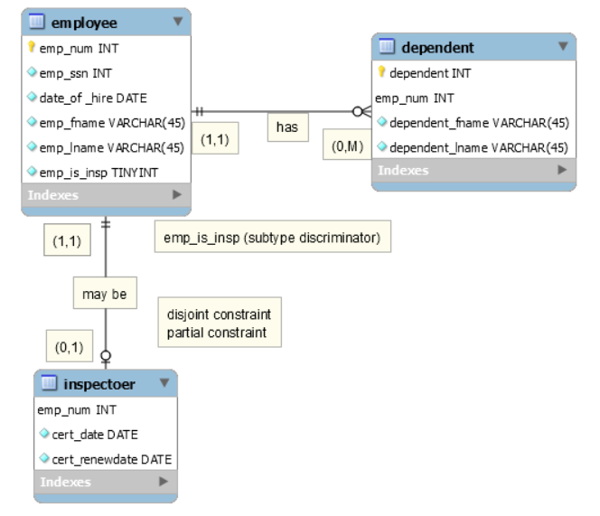
Note:
Please indicate the subtype discriminator and partial/total completeness constraint, by using a textbox with text stating the designations.
Two records in Employee table, one record in dependent table, one record in inspector table.
Please upload a .mwb file!
Notes:
Use BIGINT data type for phone number
Describe subtype discriminator
Describe completeness constraint
One data record for each table

Slide 5
SQL questions for assignment #4 (Use premiere script)
List the largest customer balance, use alias, “largest balance.”
List the average part price, rounded to two decimal places, use alias, “average price.”
List all part numbers, descriptions, and part prices (rounded to two decimal places) for parts priced between $30 and
$300, inclusive.
Remove order numbers between 12491 and 12498, inclusive, in one statement;
Update all customers’ credit limits to $2000, for those customers whose balance is less than or equal to $800.
Add three records to the order_line table, in one statement, with the following values (*MUST* use attribute names in statement):
order_number=12500, part_number=‘AX12’,number_ordered=10, quoted_price=21.99
order_number= 12500, part_number=‘CB03’,number_ordered=10, quoted_price=10.99
order_number= 12504, part_number=‘CX11’,number_ordered=10, quoted_price=24.99
Notes:
SQL Aggregate Functions
Max ,min, avg, sum
The MAX() function returns the largest value of the selected column.
The FORMAT() function formats a value with the specified format.

